Slide 1
Matched Filter:
A matched filter is used at the receiver to maximize the Signal-to-Noise Ratio (SNR) for a given transmitted signal.
It is designed to match the shape of the transmitted pulse to optimally extract the signal from noise.
Practical channel impairments (such as multipath effects) can cause signal distortion, leading to ISI.

Slide 2
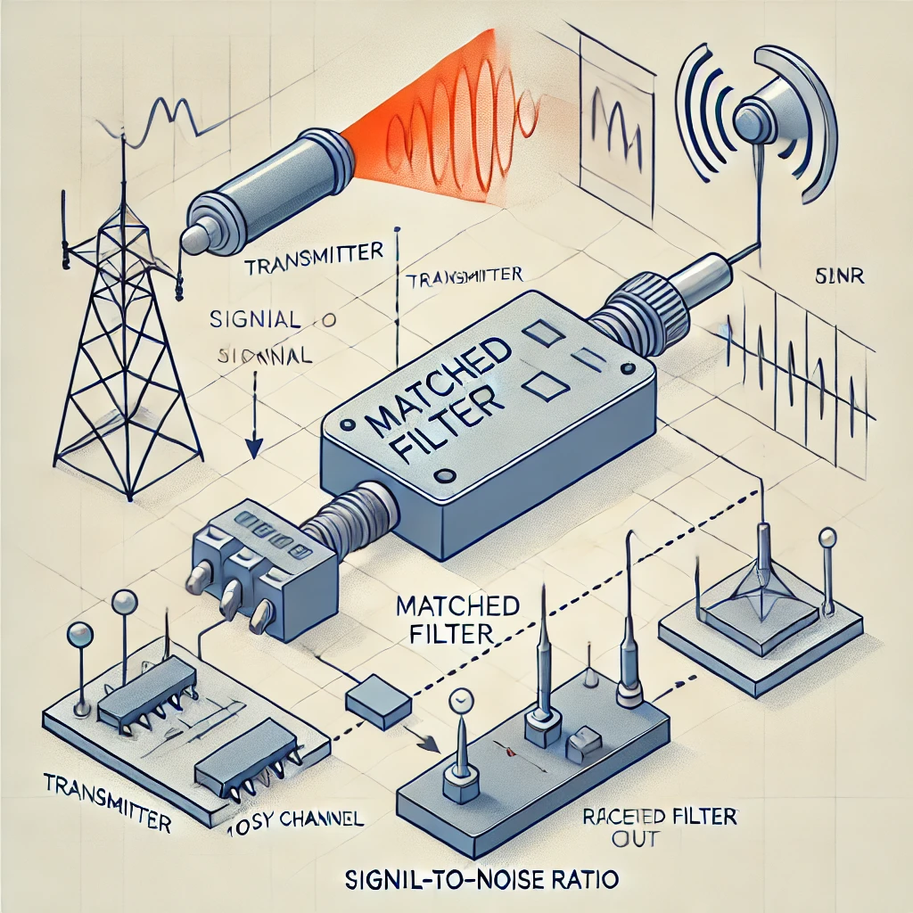
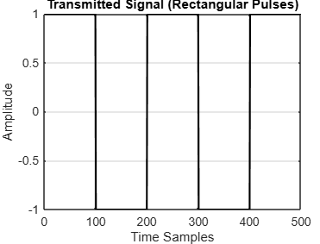
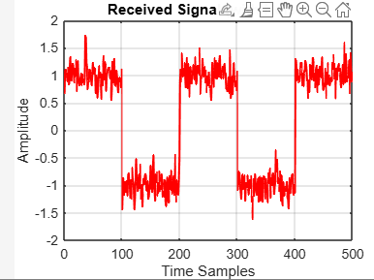
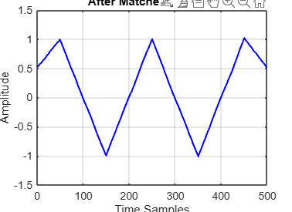

Slide 3
Inter-Symbol Interference (ISI):
ISI occurs when transmitted symbols spread into adjacent symbol periods due to channel imperfections (such as multipath propagation or bandwidth limitations).
While a matched filter maximizes SNR, it does not inherently eliminate ISI.
It can sometimes enhance it if the channel is dispersive.
To mitigate ISI, additional signal processing is required, which leads to the use of equalizers.

Slide 4
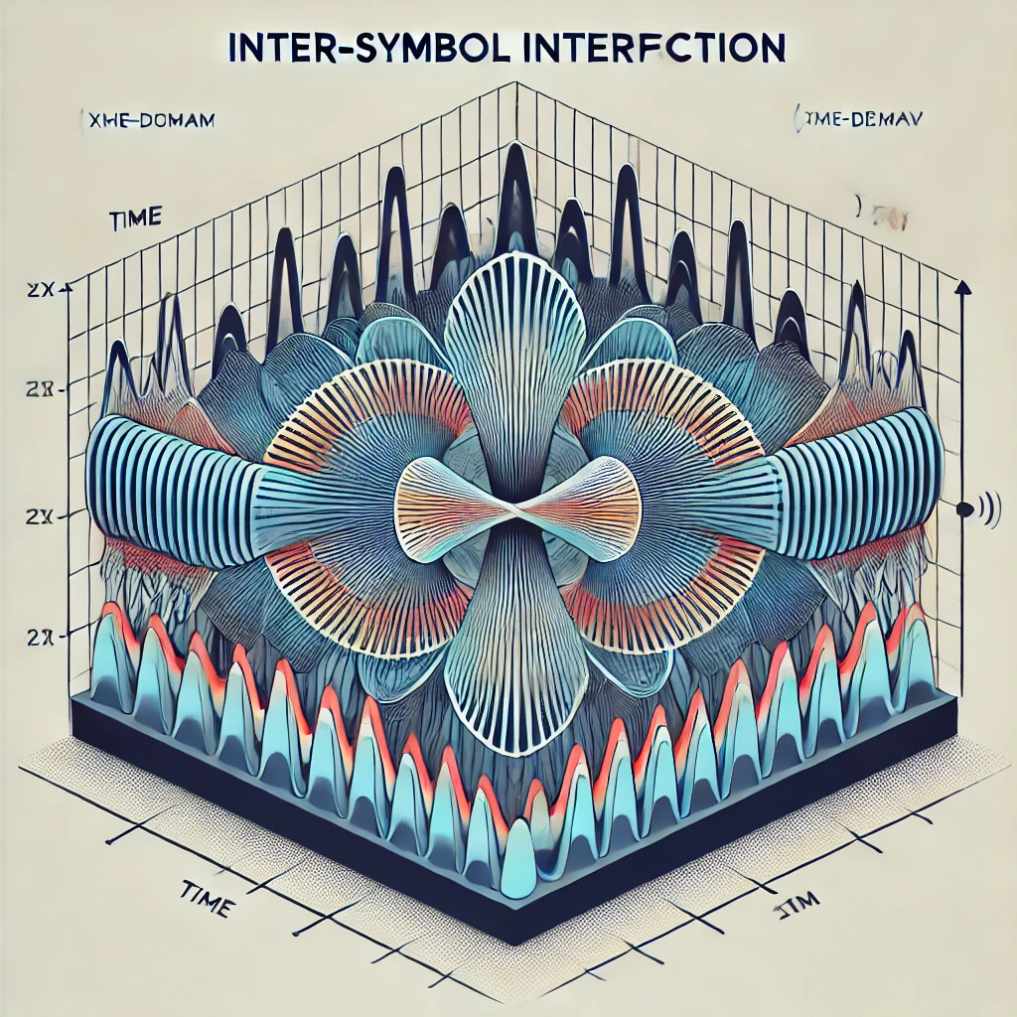
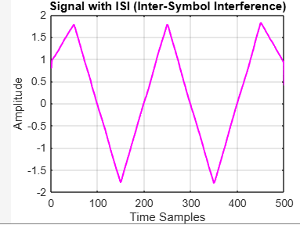

Slide 5
Equalizers:
Equalizers are used to counteract ISI and recover the transmitted symbols as accurately as possible.
They attempt to invert the channel effects and restore signal integrity.
Common types of equalizers include linear equalizers, decision feedback equalizers (DFE), and adaptive equalizers like the Least Mean Squares (LMS) algorithm.

Slide 6
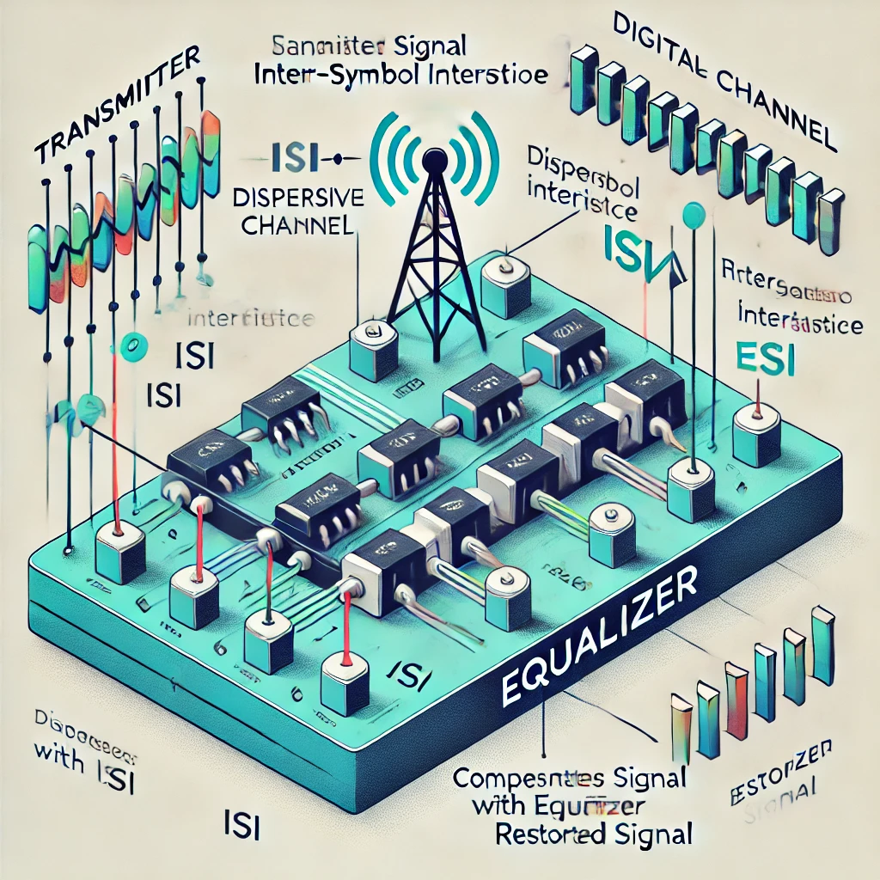
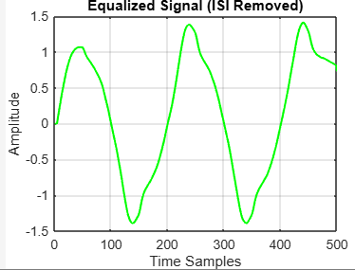

Slide 7
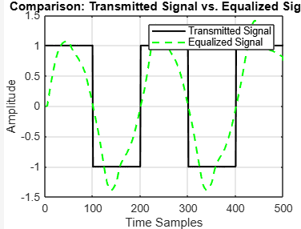
A matched filter is typically the first step in the receiver to improve SNR.
If the channel introduces ISI, the matched filter alone is not enough, and equalizers are used to mitigate ISI and recover the transmitted data.
Matched filters enhance SNR,
ISI is an unwanted effect caused by the channel
Equalizers are used to overcome ISI and improve signal detection.

Slide 8
The transmitted signal consists of rectangular pulses, representing digital symbols (e.g., 1, -1, 1, -1).
In the frequency domain, a square wave has high-frequency components, making it look sharp in the time domain.
(a) Matched Filtering Effect
The matched filter is typically a low-pass filter, designed to maximize SNR.
It removes high-frequency components, causing the signal to lose its sharp edges.
This makes the signal look more rounded and less like a perfect square wave.
(b) Channel Effects (ISI and Multipath)
The channel introduces inter-symbol interference (ISI), which causes spreading and overlap between symbols.
This further smoothens the signal because adjacent symbols start affecting each other.
(c) Equalization Process
The LMS equalizer aims to remove ISI, but it does not perfectly reconstruct the original sharp edges.
It compensates for distortions but may still preserve some filtering effects, leading to a smoother waveform.
The equalizer output is usually closer to the original signal but not exactly a square wave.

Slide 9
If the system had ideal infinite bandwidth and no noise, we would recover the perfect square wave.
In practical systems:
The receiver filter limits the signal bandwidth.
Equalization improves symbol detection but does not necessarily reconstruct sharp transitions.
The band-limited nature of real-world channels prevents perfect square wave recovery.
to Improve Square Wave Recovery
✅ Use a Higher Bandwidth Channel
A wider channel bandwidth allows sharper transitions to be preserved.
✅ Apply Nonlinear Equalization (e.g., Decision Feedback Equalizer - DFE)
This can better restore sharp transitions compared to linear equalizers.
✅ Use a Different Transmit Pulse Shape (e.g., Raised Cosine Filter)
Some pulse shapes reduce ISI while keeping transitions sharper.
The received equalized signal looks smoother because:
Matched filtering removes high-frequency components.
ISI spreads symbol edges, further smoothing the waveform.
The equalizer compensates for distortions but does not fully recover the original sharp transitions.
Practical systems always have bandwidth limitations that prevent perfect square wave reconstruction.

Slide 10
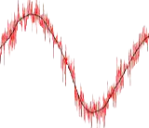

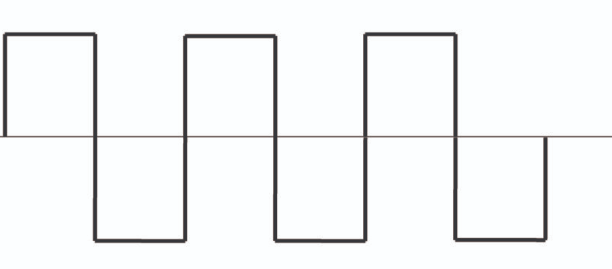
EYE DIAGRAMS
SUMMARIZES THE EFFECTS OF ISI BY SHOWING RESPONSES OF 0’S AND 1’S
GENERATED BY OVERLAYING PLOTS OF RECEIVED SIGNAL FOR EVERY SYMBOL
RESULTANT LOOKS LIKE AN EYE AND HENCE CALLED EYE DIAGRAM
PRACTICAL SCENARIO
1 0 1 0 1 0
MAGNITUDE 1
IN CASE OF IDEAL RECEPTION
MAGNITUDE 0
DECISSION MAKING INSTANT
Higher the eye opening, lower the ISI.
Higher the data rate, lower the eye opening.

Slide 11
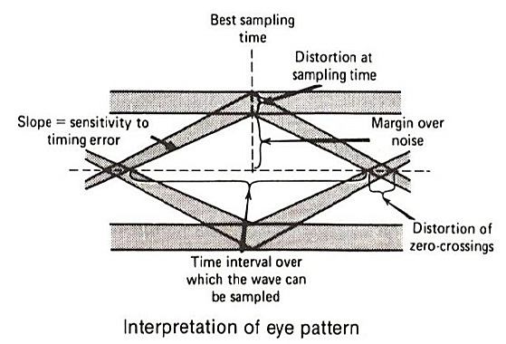
WIDTH OF EYE OPENING
TIME INTERVAL OVER WHICH THE RECEIVED DISTORTED SIGNAL CAN BE SAMPLED WITH MINIMUM ERROR
DISTORTION OF 1’S
MARGIN WITHOUT SIGNAL ERROR
SENSITIVITY OF THE SYSTEM TO TIMING
RATE OF CLOSURE OF EYE PATTERN WHEN SAMPLING TIME IS VARIED
DISTORTION OF TIMING
DISTORTION OF 0’S
MARGIN OVER NOISE
HEIGHT OF EYE OPENING FOR SPECIFIED SAMPLING TIME

Slide 12
Nyquist criterion for zero ISI
The Nyquist criterion for zero ISI states that a signal can be sampled at exactly twice its highest frequency component (Nyquist rate, fs=2B) to avoid ISI. Practically achieving this ideal condition is not feasible due to several reasons.
Ideal Nyquist Filter is a Sinc Function (Non-Causal & Infinite Duration)
Sharp Cutoff in Frequency Domain Causes Ringing in Time Domain
Bandwidth Constraints
Synchronization Issues in Sampling
Channel Noise & Non-Ideal Transmission Medium
Instead of the Nyquist rate, practical systems use slightly higher sampling rates, pulse shaping, and equalization to control ISI while maintaining bandwidth efficiency.

Slide 13
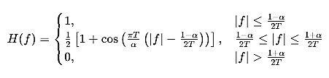
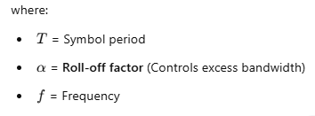
The Raised Cosine (RC) spectrum is used to minimize ISI maintaining efficient bandwidth usage.
Used in pulse shaping filters to satisfy the Nyquist criterion for zero ISI.
The Raised Cosine Filter is a frequency-domain pulse shaping function that ensures zero ISI at the sampling instants. It is defined as:
For 𝛼=0, it becomes an ideal Nyquist filter (sinc function).
For 𝛼>0, the bandwidth increases but reduces ringing effects in time domain.

Slide 14
The roll-off factor α controls the bandwidth and transition of the filter:
α Value | Effect on Spectrum | Effect on ISI
α=0 | Minimum bandwidth (Ideal Nyquist) | Sharp transitions, high ringing (ISI)
0<α<1 | Controlled bandwidth | Smooth transition, reduced ISI
α=1 | Maximum bandwidth | Very smooth, completely eliminates ISI
Higher 𝛼 => More bandwidth used but reduced ISI.
Lower 𝛼 => Less bandwidth used but more ISI risk.
Increasing α reduces ISI but requires more bandwidth!
𝛼=0 (Nyquist Sinc): Minimum bandwidth but high ISI.
𝛼=0.5: Smooth transition, moderate bandwidth.
𝛼=1: Max bandwidth, lowest ISI.

Slide 15
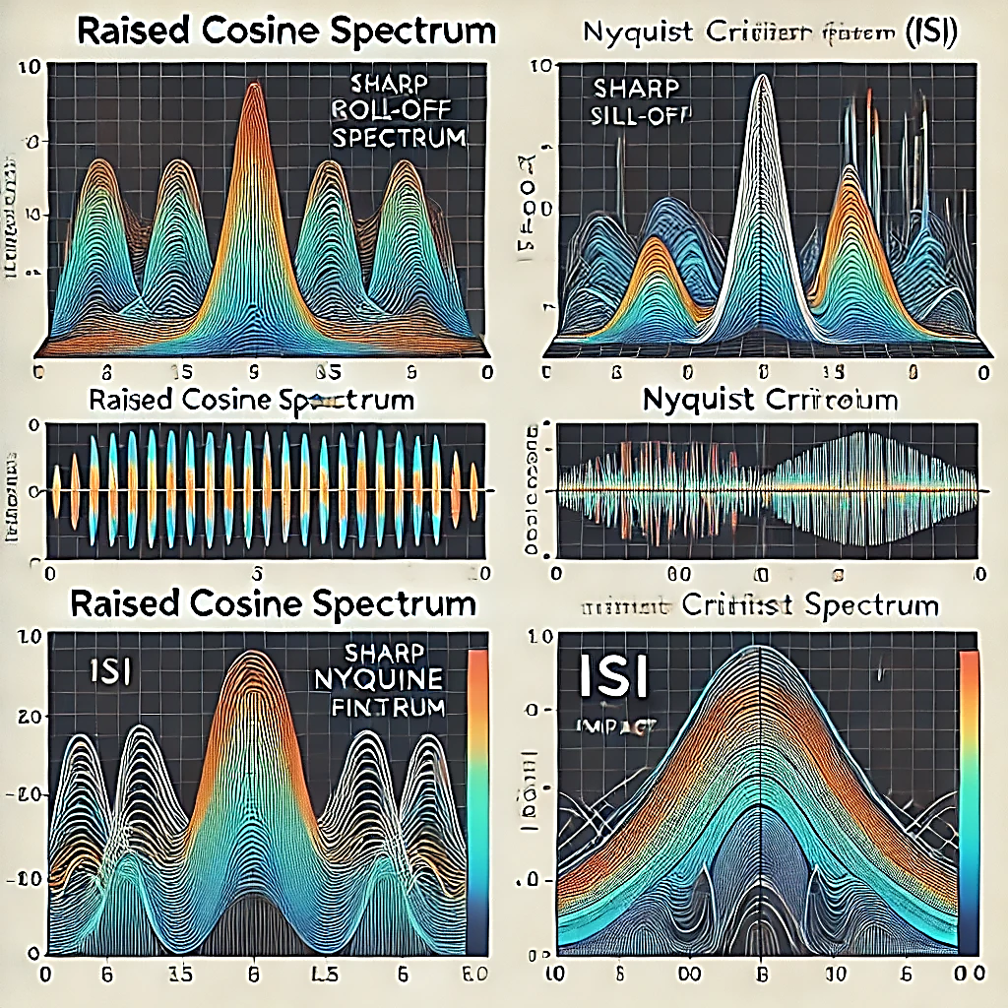
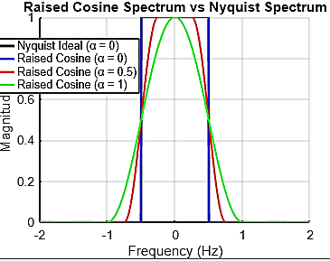
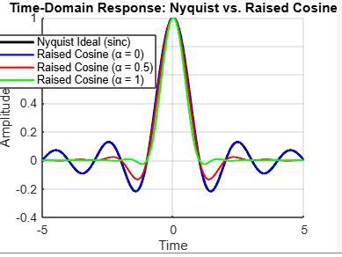

Slide 16

A telephone line normally has a bandwidth of 3000 Hz (300 to 3300 Hz) assigned for data communication. The SNR is usually 3162. What will be the capacity for this channel?
To determine the channel capacity, we use the Shannon-Hartley theorem:
C = B log2 (1 + SNR)
where:
• C is the channel capacity (in bits per second, bps),
• B is the bandwidth (in Hz),
• SNR is the signal-to-noise ratio (as a power ratio, not in dB).
Given:
• B=3000 Hz
• SNR = 3162 (not in dB, already in power ratio)
Step-by-step Calculation:
C = 3000 X 11.63 = 34.89 kbps The channel capacity is approximately 34.89 kbps.

Slide 17
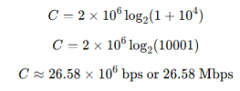
A Gaussian channel has 2MHz bandwidth. Calculate its Channel Capacity if the Signal to Noise Spectral density ratio is 10^4.
Given:
• B = 2 MHz
• SNR = 10^4 (already in power ratio)
Step-by-step Calculation: C = B log2 (1 + SNR)
The channel capacity is approximately 26.58 Mbps.

Slide 18
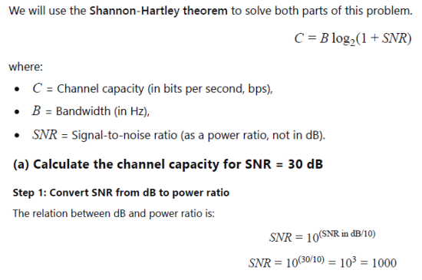
A voice grade channel of the telephone network has a bandwidth of 3.4 KHz.
Calculate channel capacity of the telephone channel for signal to noise ratio of 30 dB.
Calculate the minimum SNR required to support information transmission through the telephone channel at the rate of 4800 bits/sec.

Slide 19
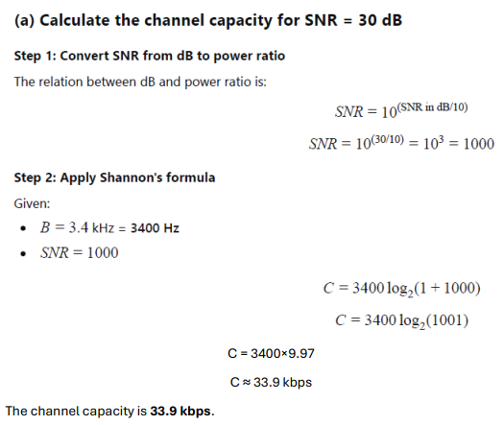

Slide 20
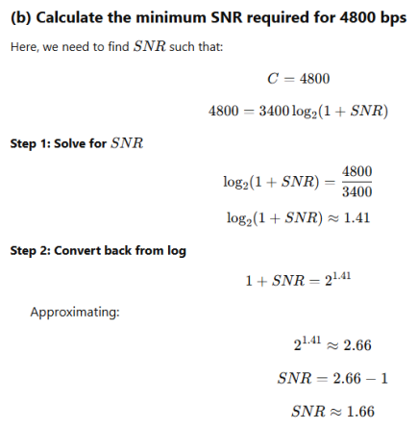

Slide 21
